Slide 1






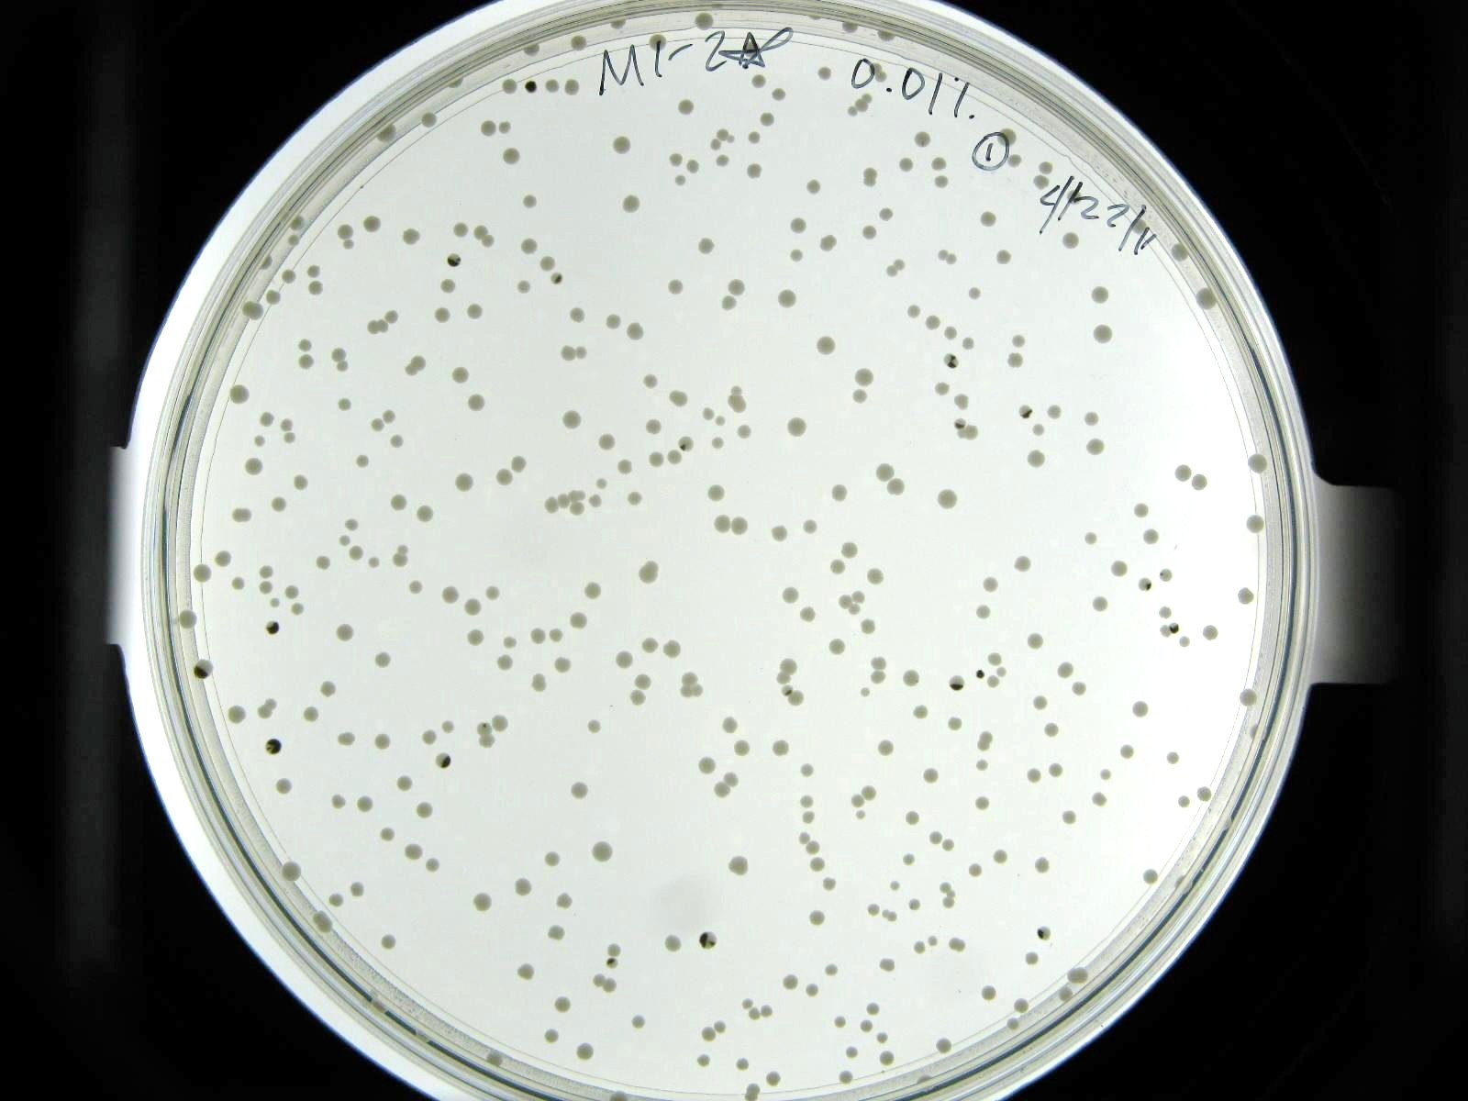
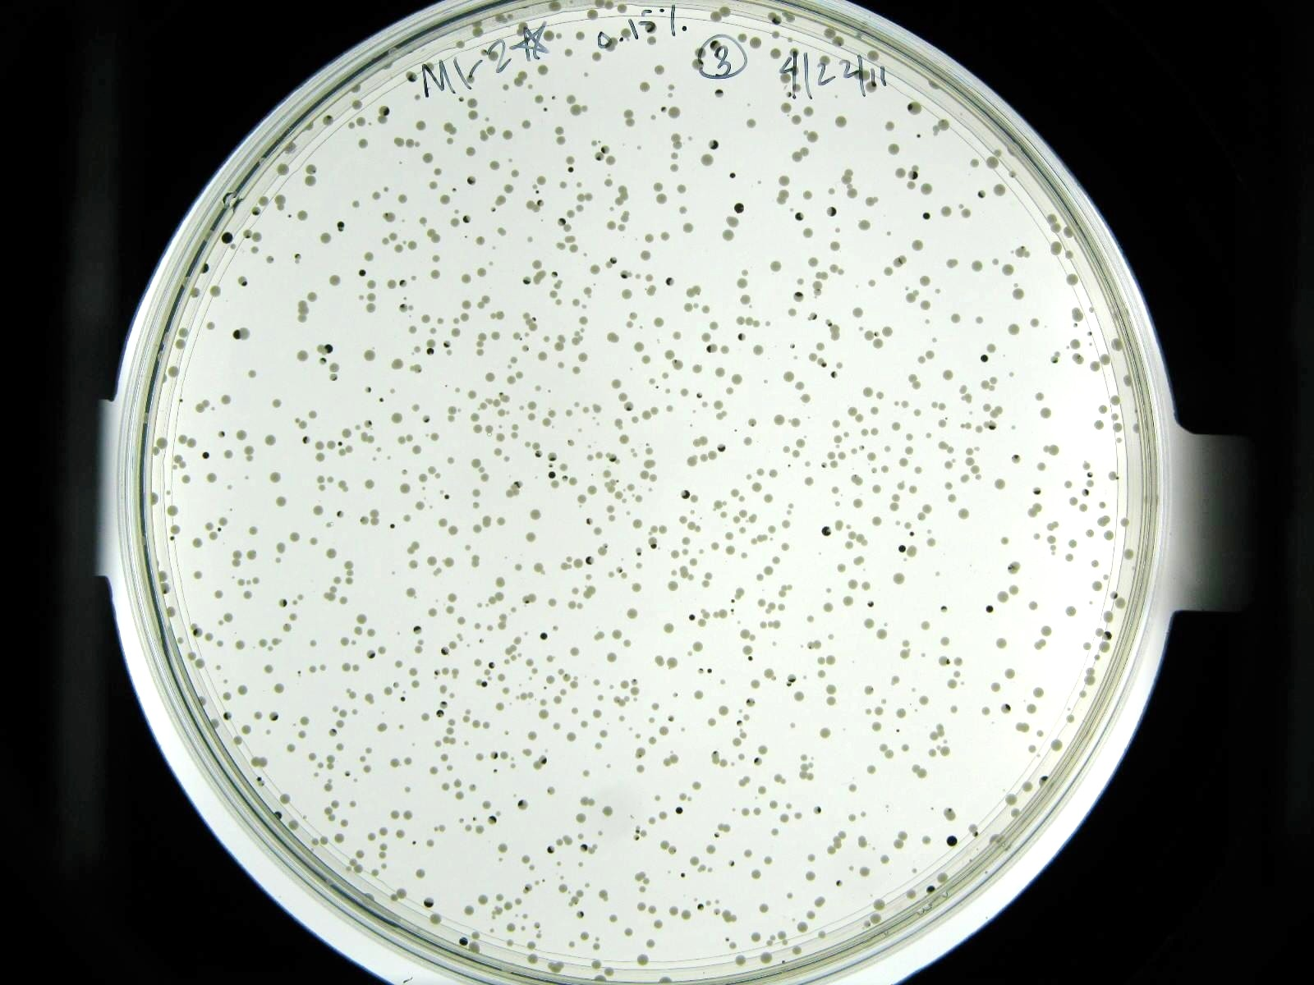
Linking Oxidative Stress to Mutation Rate During Cellular Aging in Saccharomyces cerevisiae
Lindsay Parnell
Erin Jackson, Meighan Parker, Brittni Wilson
Dr. Hong Qin, Ph.D
Spelman College, Department of Biology; Atlanta, Georgia 30314
Introduction
The biological aging system has been described as the increased likelihood for failure as time progresses. On the cellular level, factors such as oxidative stress, which is caused by the accumulation of reactive oxygen species, can onset this aging process by increasing genomic instability via DNA mutations. Mitochondrial DNA (mtDNA), more so than nuclear DNA (nDNA), is reported to have a greater susceptibility to damage caused by oxidative stress despite the protective function of circulating antioxidants.¹
What is the link between oxidative stress and mutation rate in the biological aging system? We tackled this question by using a group of nine natural diploid Saccharomyces cerevisiae isolates as a model for this phenomenon. Oxidative stress was introduced by using different concentrations of hydrogen peroxide. Mutation rates were measured by loss of heterozygosity (LOH) at the Met 15 +/- locus in a group of diploid natural yeast isolates, with high counts of LOH events indicating genomic instability and low counts indicating genomic integrity.²
R, a statistical analysis software program, was used to plot yeast viability as a function of mutation rate.
Deciphering the mechanisms and conditions under which a biological system ages is of great interest and can contribute to the understanding of age-related diseases such as cancer, Alzheimer’s disease, and cardiovascular disease.
Experimental Design
Results
H2O2
Mother Cell
met15^{+/-}
met15^{+/+}
met15^{-/-}
^{Mutation}
1st Generation
First mitotic division
Single Mutational Event
No mutational event
Figure 1. The detection of H2O2 damages in the yeast genome. During aging, there is accumulation of oxidative damages in mother cells. Mother cells tend to keep these damages within themselves. Ideally, daughter cells should be born free of damages. Hence, the partition of cellular components is asymmetric.
Modified from doi:10.1371/journal.pone.0002670
Hypothesis
We hypothesized that the frequency of loss of heterozygosity events will occur in a dosage dependent manner of H2O2. Thus, as mutation rate increases, cell viability will decrease.
The nine yeast strains used are diploid, meaning that each has two copies of the same gene. An antibiotic marker, the Kanamycin-resistance marker, was used to knock-out one copy of the Met15 +/- gene. The shaded region represents the wild-type gene (WT) and the black region is the knock-out gene. Where there is a mutation, the colony will either be fully white, as a representation of homozygosity for the WT gene or heterozygosity for the knockout and WT genes, or fully black, as an indication of homozygosity for only the knock-out gene. Note that only half of the mutational events are observed because Met15 +/- and Met15 +/+ are indistinguishable. Half-black colonies indicate a mutational event after budding has occurred.
Figure 3: Cell viability as a function of mutation rate. A) YPS163 Met15 +/- yeast strain grown on YPD plates (containing lead ions) demonstrates a greater sensitivity to H2O2 treatment. B) M34 Met15 +/- yeast strain grown on YPD plates (containing lead ions) demonstrate moderate
sensitivity to H2O2. C) M8 Met15+/- yeast strain grown on YPD plates (containing lead ions) demonstrates a greater tolerance to H2O2 treatment.*
*Graphs were generated using R script programming.
Materials and Methods
Culturing
Nine met15 +/- strains of Saccharomyces cerevisiae were grown overnight in 5 mls of 2% glucose YPD media at 30°C to reach a saturation of OD600. The culture was restaged to an OD of 0.6 and transferred into fresh YPD in new glass tubes.me of 4 to 6 mls. The culture was grown in a 30 °C shaker for 2 hours and OD600nm values were measured. OD values were expected to range from 0.8 to 1.0.
The culture was transferred to 1.0 ml to 1.5 ml eppendorf tubes and centrifuged at maximum speed for 5 minutes. YPD was poured out of each tube and an equal volume of ddH2O was added.
The cells were spun down and washed with ddH2O two more times. The eppendorf tubes were immersed in a waterbath sonicator and sonicated for 2 minutes to ensure uniform segregation of the cells.
H2O2 Dilutions
H202 solutions of 0.01%, 0.1%, 0.2%, 0.15%, 0.5%, and 0.3% were made. For each dilution, 4 μl of cells, 16 μl of water, and 20 μl of H2O2 solution (10X dilution)were added to a 1.5 ml eppendorf tube. The tubes were vortexed to distribute the cells. Tubes were wrapped in parafilm and incubated in a shaker at 30 °C for 3 hours.
During the incubation period, proper dilutions from the 1ml cell suspension (in Step 6) were made. Bright-Line counting chamber was used to estimate the cell concentrations, with the aim of putting 200 colonies on each 100 mm plate.
The H2O2 treatment reaction was terminated by adding 960 μl of water (50X dilution) and chilled on ice.
Analysis
Digital images of each plate were taken.
The number of fully black,, half-black, quarter-black, and quarter-quarter black colonies were counted and recorded .
R script was used to plot cell viability as a function of time after exposing yeast to varying concentrations of H2O2.
Diploid yeast strains with the Kanamycin-resistance marker are cultured in 2% glucose YPD media.
Appropriate H2O2 dilutions are combined with yeast cells and water in separate 1.5 ml eppendorf tubes.
Yeast are spread on Pb+ -containing plates.
Plates were incubated at 30 °C for 2 days and then transferred to room temperature for an additional 2 days.
Digital images of plates are taken.
Fully black, half-black, quarter-black and quarter-quarter black colonies are counted and recorded.
R software is used to plot LOH events as a function of cellular viability.
B
A
Figure 4: Colonies forrmed following H2O2 treatment on lead-containing YPD plates. Blue arrow point to fully black colonies. Green arrows point to half-black colonies following one mutational event. A) M1-2* yeast strain 0.01% H2O2 treatment. B) M1-2* yeast strain with 0.15% H2O2 treatment.
Figure 2. Method sequence to determine the relationship between mutation rate and oxidative stress.
Conclusions and Future Directions
The conducted experiment and results support the hypothesis that the frequency of LOH events occurs in a dosage dependent manner. We found that as mutational events increase (indicated by an increased number of fully black and half-black colonies as H2O2 dosage was increased), cellular viability decreases. Additionally, we found that there is a wide range of timing with regard to viability change.
Future directions of these findings included a linear regression analysis, which will assist in our understanding between oxidative tolerance and lifespan.
References
¹Richter C, 1995 Oxidative Damage to Mitochondrial DNA and its Relationship to Ageing. Science Direct: The International Journal of Biochemistry and Cell Biology. 647-653.
²McMurray MA, Gottschling DE, 2003 An Age-Induced Switch to a Hyper-Recombinational State. Science. 1908 -1911.
³Qin H, Lu M, Goldfarb DS, 2008 Genomic Instability Is Associated with Natural Life Span Variation in Saccharomyces cerevisiae. PLoS ONE 3(7): e2670
Acknowledgements
We would like to acknowledge the Qin Laboratory. We also give a special thanks to the Spelman College Howard Hughes Program for providing full funding to the Annual Biomedical Research Conference for Minority Students, and the NSF RUI 1022294 for support.
Notes:
Questions for Dr. Qin:
Should I also label quarter black and quarter-quarter black colonies?
How do I explain the fact that the H2O2 treatments only go up to 1.5% on the graphs even though we did up to 3% H2O2 treatments?
Should I name all of the strains used?

